Slide 1

Why even bother?
Should you go to college in the age of Generative AI?

Slide 2
Yes*

Slide 3

Context
Lots of people (such as Goldman Sachs) predict that AI could destroy 300M jobs
Generative AI is being built into autonomous agents
Post-Labor Economics is coming
Is anyone going to need work?
What degree should you pursue, if any?
I get this question a lot

Slide 4

Purpose of University
The original purpose of universities was to produce a "universal man," a well-rounded individual capable of contributing to the upper echelons of society. The focus was on a broad education covering arts, humanities, sciences, history, politics, and commerce.
Universal Man: Goal of creating well-rounded, worldly individuals.
Upper Echelons: Aimed at preparing students for societal leadership. (Ivy League still does this, btw)
Broad Education: Covering arts, humanities, sciences. Highly cultured!
Understanding History and Politics: To make informed contributions.
Commerce Knowledge: To navigate and influence the economic landscape.

Slide 5

Focus on Jobs
The German/Austrian educational revolution during the Industrial Revolution shifted the focus of public education towards producing productive workers. The system was designed to prepare individuals for the rigors of factory work, emphasizing obedience, quietude, and adherence to arbitrary rules.
German/Austrian Revolution: Shifted educational focus during Industrial Revolution.
Productive Workers: Main goal of the reformed education system.
Obedience and Quietude: Taught to prepare for factory settings.
Arbitrary Rules: Enforced to model factory-like hierarchy.
Contrast to 'Universal Man': Narrower focus compared to broad societal education.

Slide 6
Why?

Slide 7
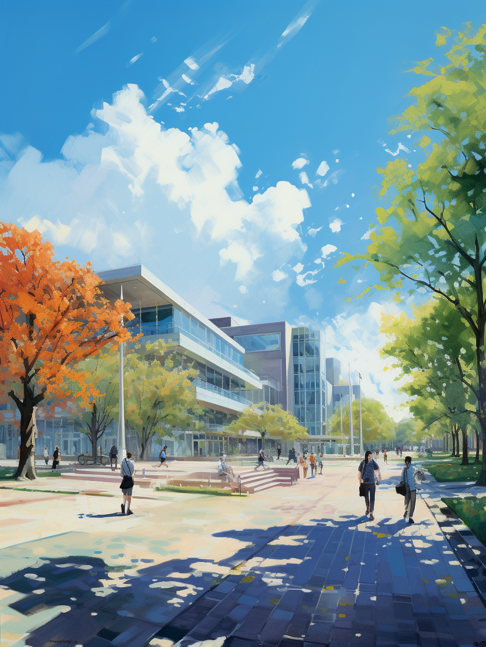
Experience
Even if AI eliminates the need for work, attending college offers valuable experiences that extend beyond career preparation. It provides a unique setting for personal growth, exposure to diverse ideas, and social enrichment.
Pressure and Challenge: Builds resilience and coping skills.
Exposure to New Ideas: A forum for intellectual exploration.
Friends and Social Groups: Opportunities for social connections and networks.
Adventures: Unpredictable experiences that contribute to personal growth.
Stretching Yourself: Learning to adapt, thrive, and expand your horizons.

Slide 8

Responsible Citizen
College education equips individuals to become responsible citizens by imparting a nuanced understanding of history, psychology, politics, economics, and society. This comprehensive knowledge enables people to better navigate the complexities of the world and contribute meaningfully to society.
History Knowledge: Understanding the past to interpret the present.
Psychology and Society: Insights into human behavior and social structures.
Political and Economic Awareness: Ability to engage in civic duties knowledgeably.
Religious and Cultural Literacy: Encouraging tolerance and empathy.
Balancing the World: Contributing effectively to societal betterment.

Slide 9

Team Player
The college experience is a valuable training ground for learning teamwork. It places students in settings where they must collaborate with diverse individuals, some of whom they may not naturally get along with. This skill is highly valued in the workplace and is often a reason employers prefer college graduates.
Diverse Interactions: Exposure to people with different opinions and backgrounds.
Conflict Resolution: Learning to work through disagreements constructively.
Collaboration Skills: Ability to contribute to a team effectively.
Real-world Prep: Fosters the adaptability needed for future professional settings.
Universally Valuable: The world would be a better place if more people were team players.

Slide 10
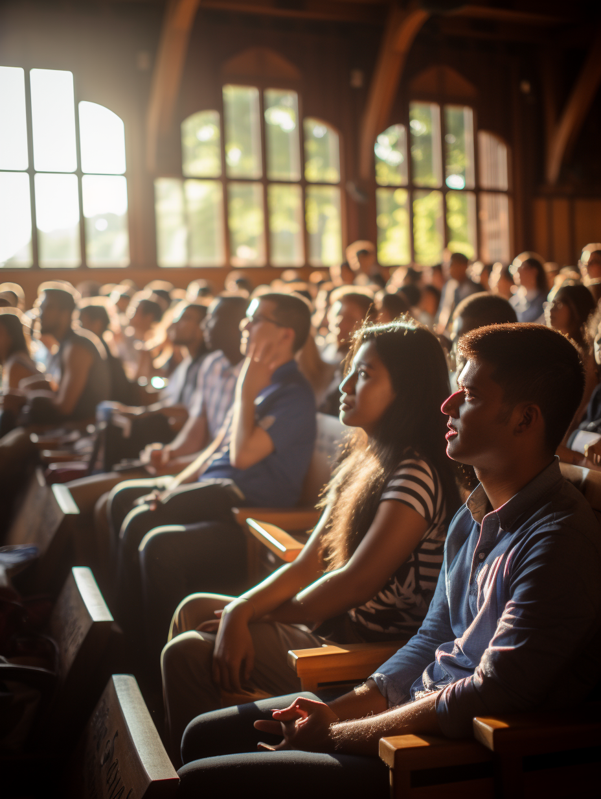
Cognitive Development
Attending college is a catalyst for cognitive development. Whether it's gaining new knowledge or honing problem-solving skills, the intellectual growth experienced during college is invaluable in life. Intelligence is not a fixed trait but a malleable quality that can be developed, making you a more capable individual in all aspects of life.
Knowledge Gain: Exposure to new information and disciplines.
Problem-Solving: Enhanced ability to tackle challenges.
Thinking Skills: Development of analytical and critical thinking.
Metacognition: Improved self-awareness and understanding of one's own learning.
General Benefit: Higher intelligence is universally advantageous.

Slide 11
What?

Slide 12

Passions
College isn't just about earning potential; it's an ideal space to follow your passions. The importance of passion in education is unmatched; it drives engagement, depth of understanding, and provides a sense of purpose. Whether young or older, many attend college solely to delve into areas they are passionate about, irrespective of commercial viability.
Engagement: There is no substitute for passion.
Depth of Understanding: Interest in a subject leads to more meaningful learning.
Sense of Purpose: Passion provides a guiding compass in academic pursuits.
Beyond Commercial Viability: Many choose fields with low earning potential but high personal value.
Life Stage Irrelevant: Age doesn't matter when it comes to pursuing what you love.

Slide 13

Right Person
College serves as a platform to intentionally build oneself into a well-rounded individual. Whether it's social skills, academics, or other areas of growth, college presents endless opportunities for self-improvement. The aim is to become a 'universal man or woman,' reaching one's pinnacle and thereby enjoying a life full of love, joy, and adventure.
Intentional Growth: College is the space to deliberately work on one's weaknesses.
Skill Diversification: Offers a wide range of subjects and experiences to build a balanced skill set.
Self-Improvement: Access to resources and networks aids in becoming a better version of oneself.
Universal Man/Woman: Strive to be well-rounded and excel in multiple dimensions.
Quality of Life: Becoming the right agent ensures a more fulfilling, enriched life.

Slide 14

STEM Education
Even in a world where AI takes over jobs, understanding STEM (Science, Technology, Engineering, Mathematics) remains crucial. These subjects provide a foundational understanding of our reality and create a shared lexicon, which is indispensable for a well-rounded individual.
Foundational Knowledge: STEM subjects teach the basic principles that underpin our universe.
Common Lexicon: Understanding STEM terms and concepts aids in cross-disciplinary dialogue.
Base Reality: Equips individuals with a deeper understanding of the world, beyond job utility.
Irreplaceable Skills: Certain aspects of STEM remain uniquely human and are essential for nuanced understanding.
Enriched Perspective: Understanding the mechanics of machine intelligence and other STEM fields enhances one's worldview.

Slide 15

Civic Responsibility
University education serves as a platform for individuals to become responsible, civically-engaged citizens. Despite advancements in AI, the essence of human society will likely remain fundamentally human, making civic education invaluable.
Understanding Governance: Courses in politics, law, and social sciences instill knowledge essential for civic participation.
Ethical Framework: Education equips individuals with the ethical considerations necessary for responsible decision-making.
Community Engagement: Skills for community involvement and leadership are often nurtured in a university setting.
Informed Voting: An educated populace is more capable of making informed choices in democratic processes.
Human-Centric: As technology evolves, the need for an understanding of human values and norms remains constant.

Slide 16
Exceptions?

Slide 17

Not For Everyone
While university offers structured avenues for growth, personal development, and civic responsibility, it's not the only pathway. The ultimate aim is to engage meaningfully with life and to continuously challenge oneself.
Alternative Education: Vocational schools, online courses, and apprenticeships are valid paths.
Conformity: Some people thrive in more self-directed environments, focusing on specific skills or knowledge.
Financial Considerations: The cost of university may not align with everyone's financial situation or long-term goals.
Unique Goals: Personal aims may not necessitate a university degree.
Seek Challenges: Regardless of the educational path chosen, seeking challenges remains crucial for growth.

Slide 18

Harmful Environment
Universities, often designed to foster learning and personal growth, can inadvertently become environments that harm certain individuals due to various factors such as social dynamics, disability, and diversity considerations.
Social Dynamics: Hierarchies, competition, and social pressures can exacerbate mental health issues.
Disability: Physical and mental disabilities may not be adequately accommodated, leading to undue stress.
Diversity & Inclusion: Lack of representation and inclusivity can make marginalized groups feel isolated or targeted.
Academic Pressure: The rigor and pace may not suit everyone, leading to burnout and deteriorating mental health.
Financial Stress: High costs and potential debt can be detrimental to emotional well-being.

Slide 19
Final Thoughts
Pretty much all my friends have degrees
Some of my best friends all have graduate degrees (including my wife)
I’ve learned to recognize the deficits I could have overcome with college
Once we achieve PLE, I will probably go to some kind of university
Personal Reflections

Slide 20
Thank you

